Slide 1

Quorum-Based Distributed File System using Python and gRPC
Team Members: Uday Kumar Dasari – 101166798 Lalitha Priya Bijja - 101168225

Slide 2
Goals
Create a distributed file system using Python and gRPC.
Implement a quorum protocol to ensure consistency.
Develop clients supporting read-heavy, write-heavy, balanced, and state-checking workloads.
Measure the performance of the system in terms of read and write latency.

Slide 3
Distributed File System
DFS is designed to enable the sharing of files across a network of computers, allowing users to access and manage files as though they were stored locally, even if they are distributed across different locations.
Egs: Google File System, Hadoop Distributed File System
Advantages:
Fault tolerance: Data replication ensures that the failure of one machine does not result in data loss.
High availability: Multiple copies of data ensure that it can be accessed even if some servers are down.
Scalability: Easily scale by adding more nodes to the system.
Cost-effective: By using commodity hardware and distributed systems, DFS can offer affordable solutions to handle large amounts of data.

Slide 4
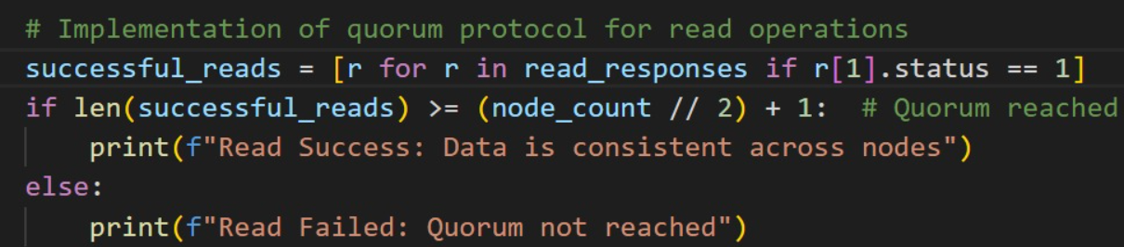
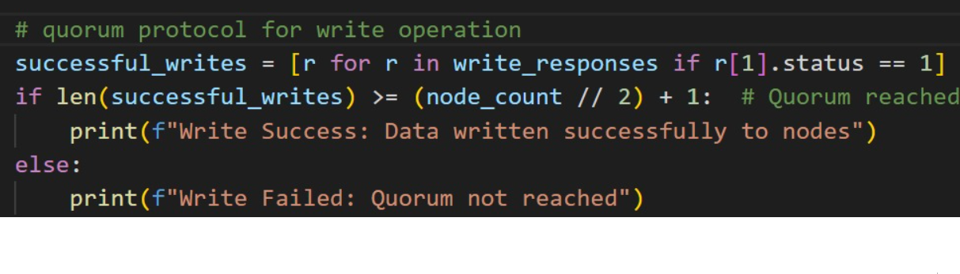
Quorum Protocol
A quorum is a subset of nodes required to participate in an operation (e.g., read or write).To ensure consistency:
Read quorum (R): The minimum number of nodes required for a successful read.
Write quorum (W): The minimum number of nodes required for a successful write.
The total number of nodes in the system is denoted as N.
Quorum Rules:
The protocol ensures consistency by satisfying>N This guarantees overlap between read and write quorums, so at least one node has the latest data. Typical setups might be: R=1 and W=N for write-heavy workloads. R=N and 𝑊=1 for read-heavy workloads=W=⌈ for balanced workloads.
Write Operation: The client writes data to at least W nodes. A write is considered successful when it reaches the required quorum of W nodes.
Read Operation: The client reads data from at least R nodes. If there is any inconsistency among the nodes, the latest version (typically identified by a timestamp) is returned.
Fault Tolerance: Quorum-based protocols tolerate up to N−max(R,W) node failures.
Fig: Quorum protocol implementation for read operation
Fig: Quorum protocol implementation for write operation

Slide 5
System Design
System Components (Architecture):
SuperNode
DataNode
Clients
Step – by – step workflow
Client makes a request
SuperNode Coordinates
DataNode Handles the Operation
Consistency with Quorum
Types of Clients
Read –Heavy Clients
Write-Heavy Clients
Balanced Clients
Handling Mixed Workloads
Performance Monitoring

Slide 6
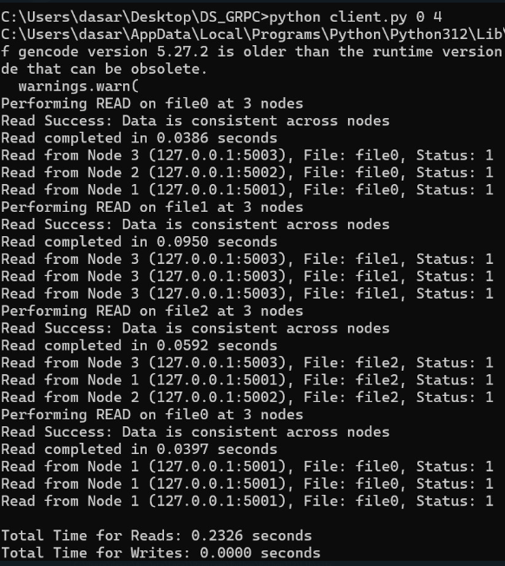
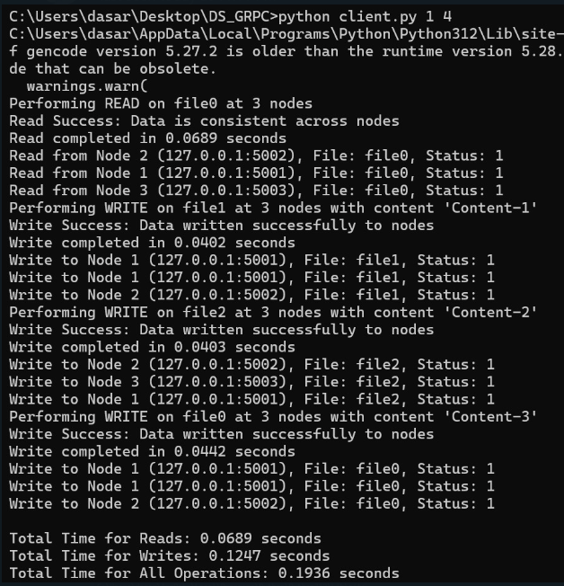
Results
Fig: Read – Heavy Output
Fig: Write – Heavy Output

Slide 7
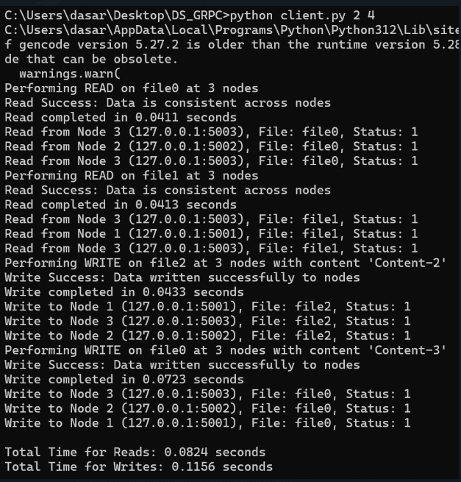
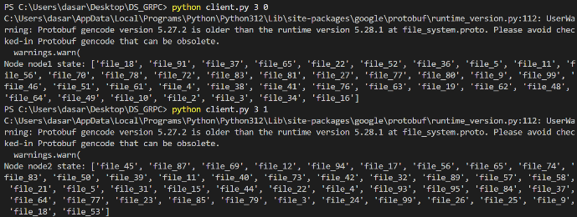
Fig: Node state of Node 1 & Node 2
Fig: Balanced Output

Slide 8
Conclusion
High Performance: Low latency for read and write operations, even under heavy load.
Fault Tolerance: Effective handling of node failures and network partitions. File replication and quorum-based consistency ensured reliability.
Scalability: Horizontal scalability for handling increasing workloads.
Real-Time Monitoring: Provided transparency and stability across the system.
Use Case Versatility: Suitable for enterprise data storage, real-time file sharing, and cloud-based applications.
System Reliability: Robust performance during node failures and high-load conditions.
Effective Design: Scalability and high availability make it suitable for resilient distributed file storage solutions.

Slide 9
Future Work
Advanced Fault Recovery Mechanisms: Explore erasure coding and dynamic replication strategies.
Integration with Emerging Technologies
Enhanced Security Features
Improved Load Balancing

